Slide 1
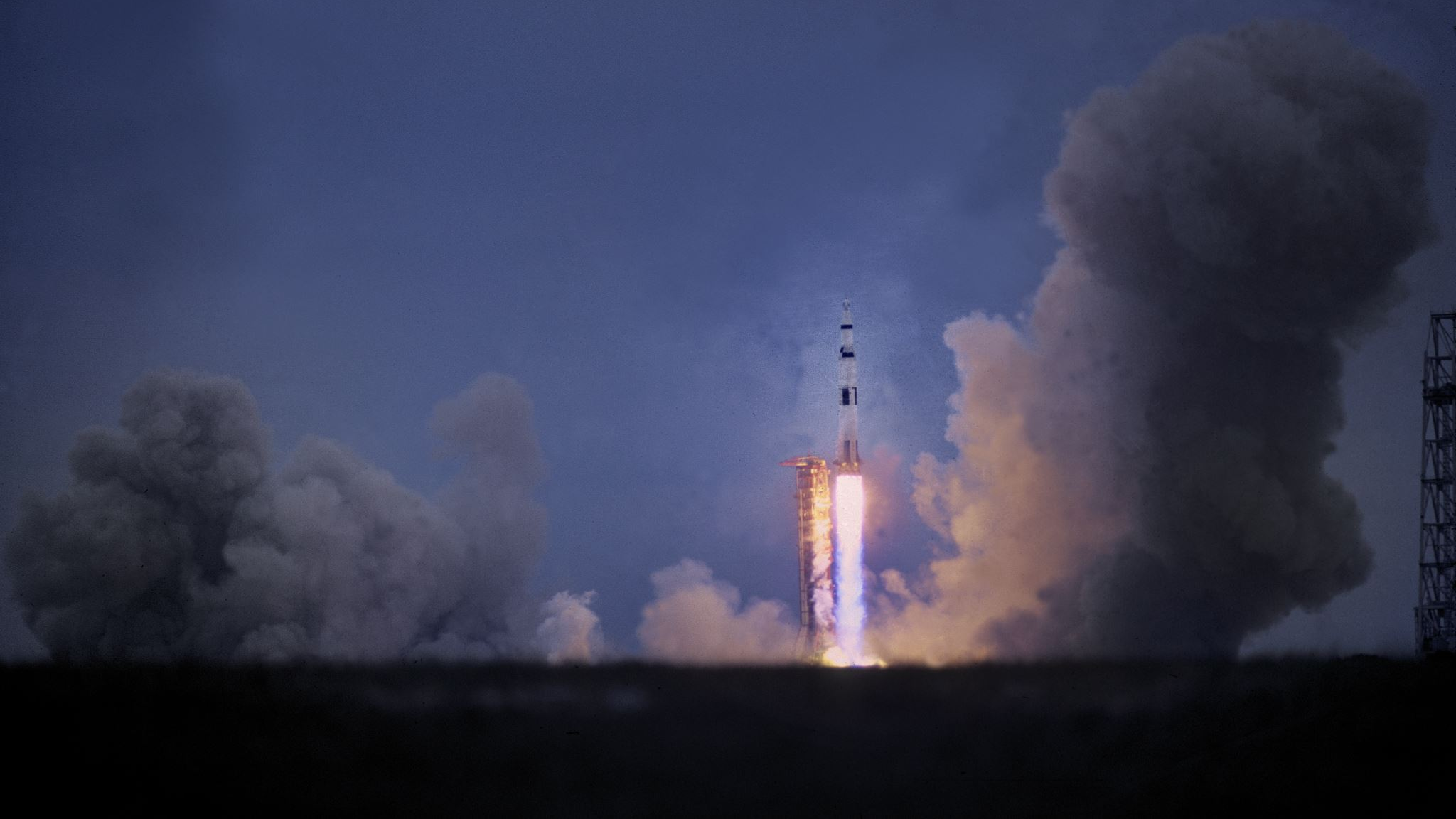
Racing in Space
Need for Speed in space

Slide 2
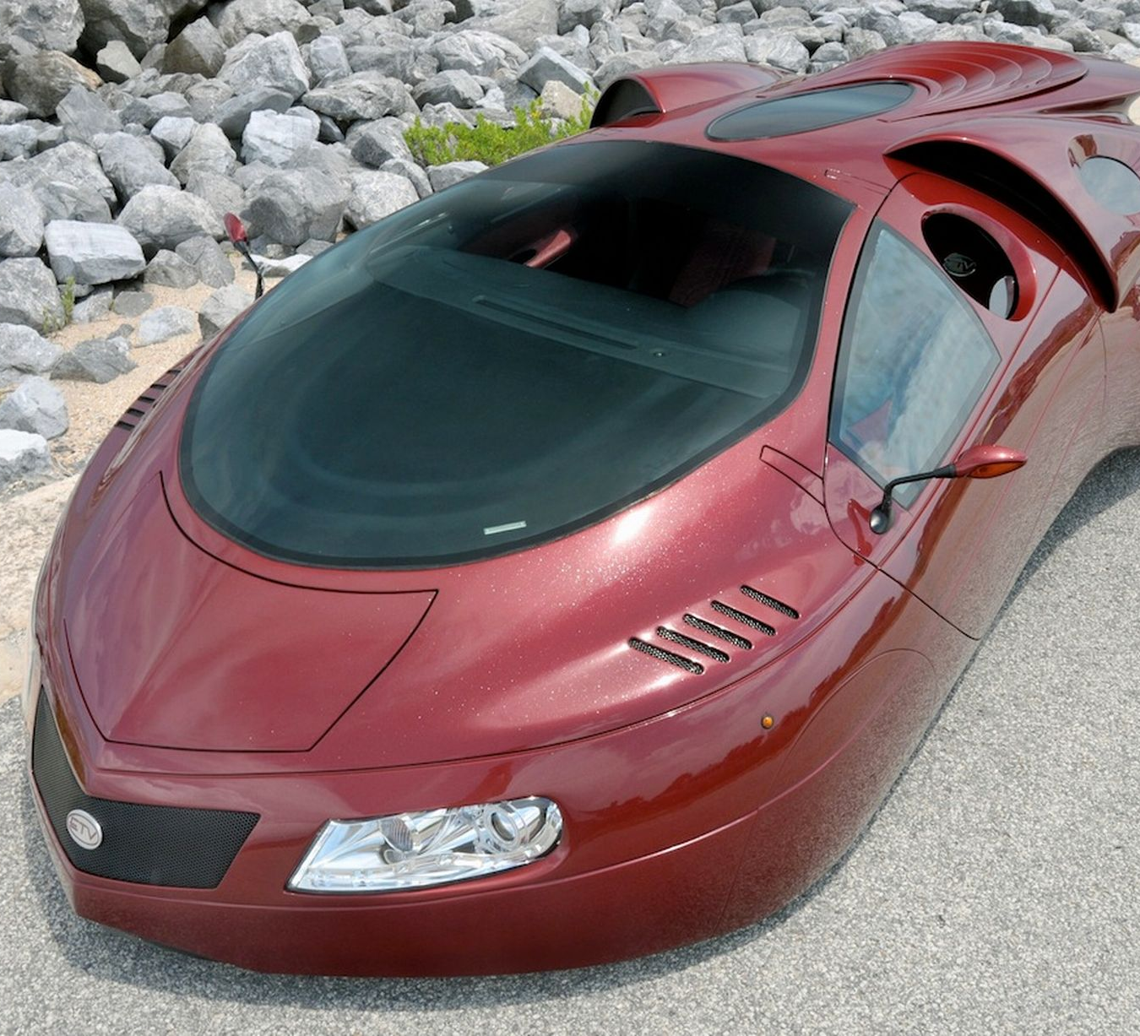
Futuristic Car
In this age people can race in space using futuristic cars that look weird and funny.

